Slide 1
Question Answering Model using Vertex AI and Haystack
Submitted by
Teepika Ramasamy Marimuthu
Duncan Inganji
Shreya Goyal
Jagruti Mohanty

Slide 2
Agenda
Introduction
Related Work
Data
Methods
Experiments and Results
Conclusion and Future Work
Link for project walkthrough video and code

Slide 3
Introduction
Question Answering System model helps generate answers for the questions in an interactive manner. In this project, we have implemented state-of-the-art deep learning models for Question Answering such as transformer models roberta and distilbert For training the model, we have used SQUAD and SELQA data sets. Two approaches that we have implemented :
Haystack is used for extractive QA pipeline.The model uses a question answering pipeline consisting of Retriever and Reader to serve the requests. The model used is RoBERTa, and training data is a combination of SQuAD 2.0 and SELQA.
Vertex AI Pipelines help in automating, monitoring, and orchestrating the ML workflow in a serverless manner and storing the artifacts using vertex ML metadata. Vertex AI to deploy the endpoint. The model is trained using distilled Bert for Question Answering, and the endpoint is deployed.

Slide 4
Related Work
In one of the research , the study compares both multilingual and Swedish monolingual inherited BERT models for question answering utilizing both an English and a Swedish machine translated SQuADv2 data set during its fine-tuning process. The models are evaluated with SQuADv2 benchmark and within an implemented question answering system built upon the classical retriever-reader methodology. This study introduces a naive and more robust prediction method for the proposed question answering system as well finding a sweet spot for each individual model approach integrated into the system. The question answering system is evaluated and compared against another question answering library at the leading edge within the area, applying a custom crafted Swedish evaluation data set. The results show that the fine-tuned model based on the Swedish pretrained model and the Swedish SQuADv2 dataset were superior in all evaluation metrics except speed.

Slide 5
Data
For vertex AI implementation, the dataset is SQUAD 2.0 dataset. Stanford Question Answering Dataset (SQuAD) is a reading comprehension dataset, consisting of questions posed by crowdworkers on a set of Wikipedia articles, where the answer to every question is a segment of text, or span, from the corresponding reading passage, or the question might be unanswerable. SQuAD2.0 combines the 100,000 questions in SQuAD1.1 with over 50,000 unanswerable questions written adversarially by crowdworkers to look similar to answerable ones.
To create a haystack pipeline SELQA dataset is used. The SelQA dataset provides crowdsourced annotation for two selection-based question answer tasks, answer sentence selection and answer triggering. This dataset composes about 8K factoid questions for the top-10 most prevalent topics among Wikipedia articles.

Slide 6
Methods
The training starts with preprocessing steps of the input text
With all text preprocessing steps implemented, start_positions and end_positions are set and tokenized examples are returned as a result of our preprocessing step.
Training is initiated with essential arguments like evaluation_strategy, learning_rate, reporting to weights & biases etc
As a final step, we built a haystack index of InMemoryDocumentStore type with FARMReader and TfidfRetriever
The haystack index is written with the wiki articles about Game of Thrones and the index is queried against the relevant questions to test the performance.

Slide 7
Experiments and Results
To experiment with the MLOPS perspective of our implementation, we built a QA pipeline from scratch in Vertex AI.
For building this pipeline, we used TFDistilBertForQuestionAnswering.
We utilized the single distribution strategy since only one gpu device - NVIDIA_TESLA_V100 is used for training
All the training code with preprocessing steps are written as a single file, built into a training image with all the required dependencies and pushed to google container repository for training.
Once the model is trained, it is deployed as an endpoint for future inference.

Slide 8
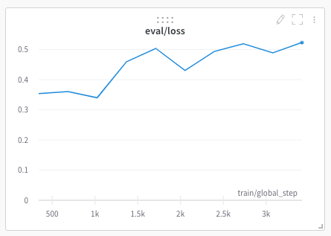
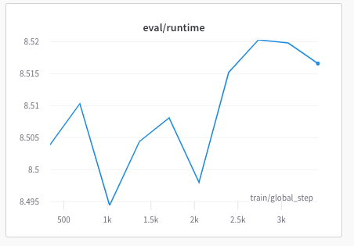
Experiments and Results

Slide 9
Conclusion and Future Work
With this implementation we have demonstrated the use of Vertex AI and Haystack for Natural Language Processing task of question answering.We have implemented by fine tuning state of art models.
The future direction of work will be to integrate it with a full-stack web application to utilize the functionality of the question-answering feature and improve the model performance by hyperparameter tuning or using other state-of-the-art models in natural language processing.

Slide 10
Link for project walkthrough video and code
Video Link:
https://www.youtube.com/watch?v=KOoG3QEPCRU
Project Link:
https://github.com/duncaninganji/cmpe297

